Slide 1

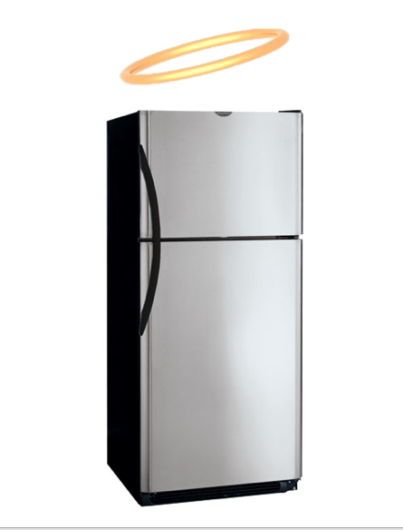
Smart Refrigerator Application
Development Team
Will Foti
Nick Henry
Meghan McEachern
John Owens
Nicole Poirier
Evan Roberts
Furay Unukpo
Notes:
Refrigerator with a halo; alphabetical

Slide 2

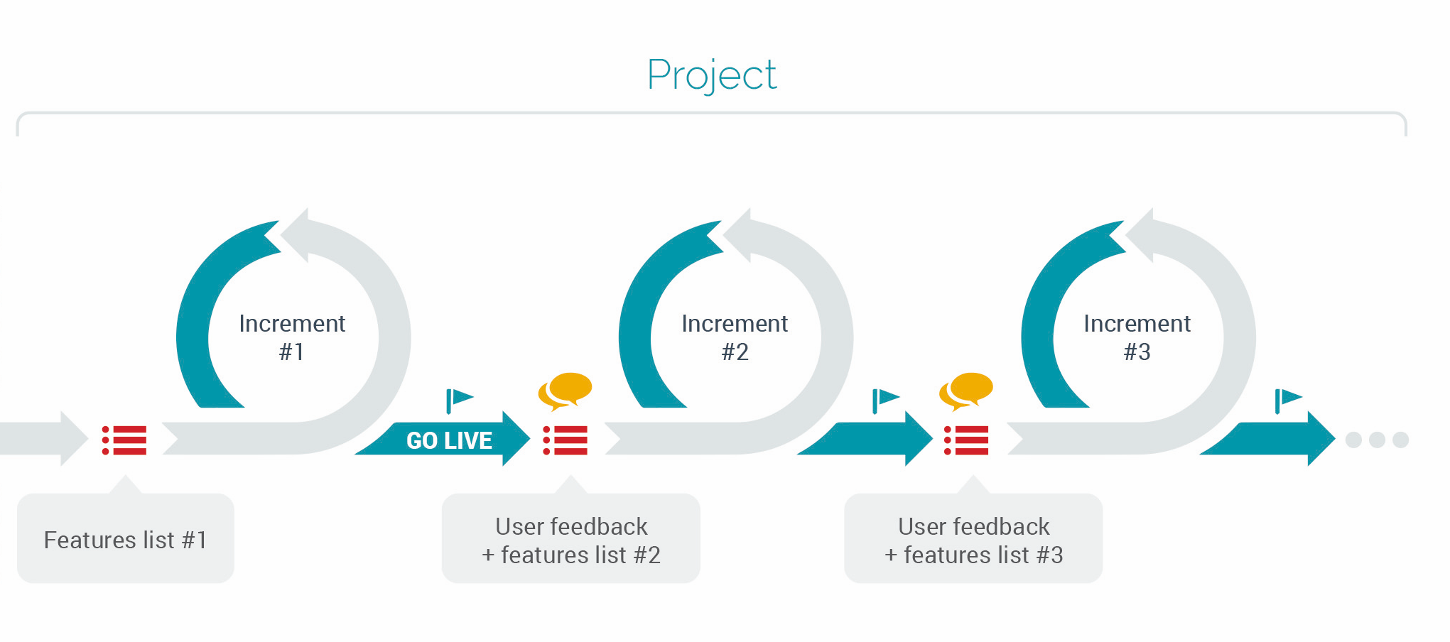
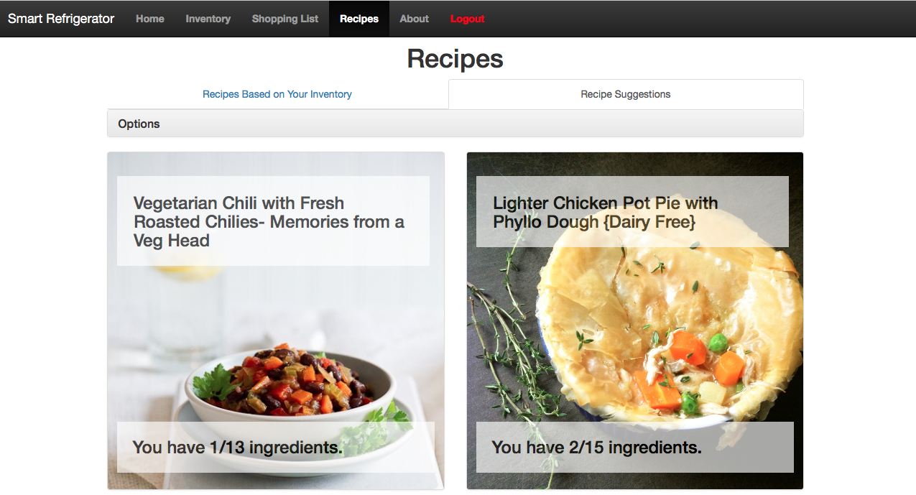
Today, you will see what inspired this application, how our group developed it,
and how the product functions in everyday life
Project Sprints
Project Inspiration
Development Process
Features List and Scenario

Slide 3
Project Inspiration

Slide 4
The world is in need of more information and is demanding greater connections with our devices referred to as the Internet of Things (IoT)

Slide 5
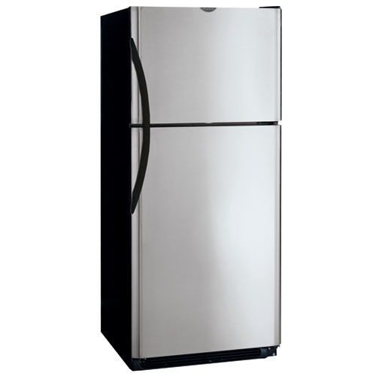
A simple device, which houses a significant dollar value of food, is the refrigerator. Until recently, it has been an unmanaged appliance within the home

Slide 6
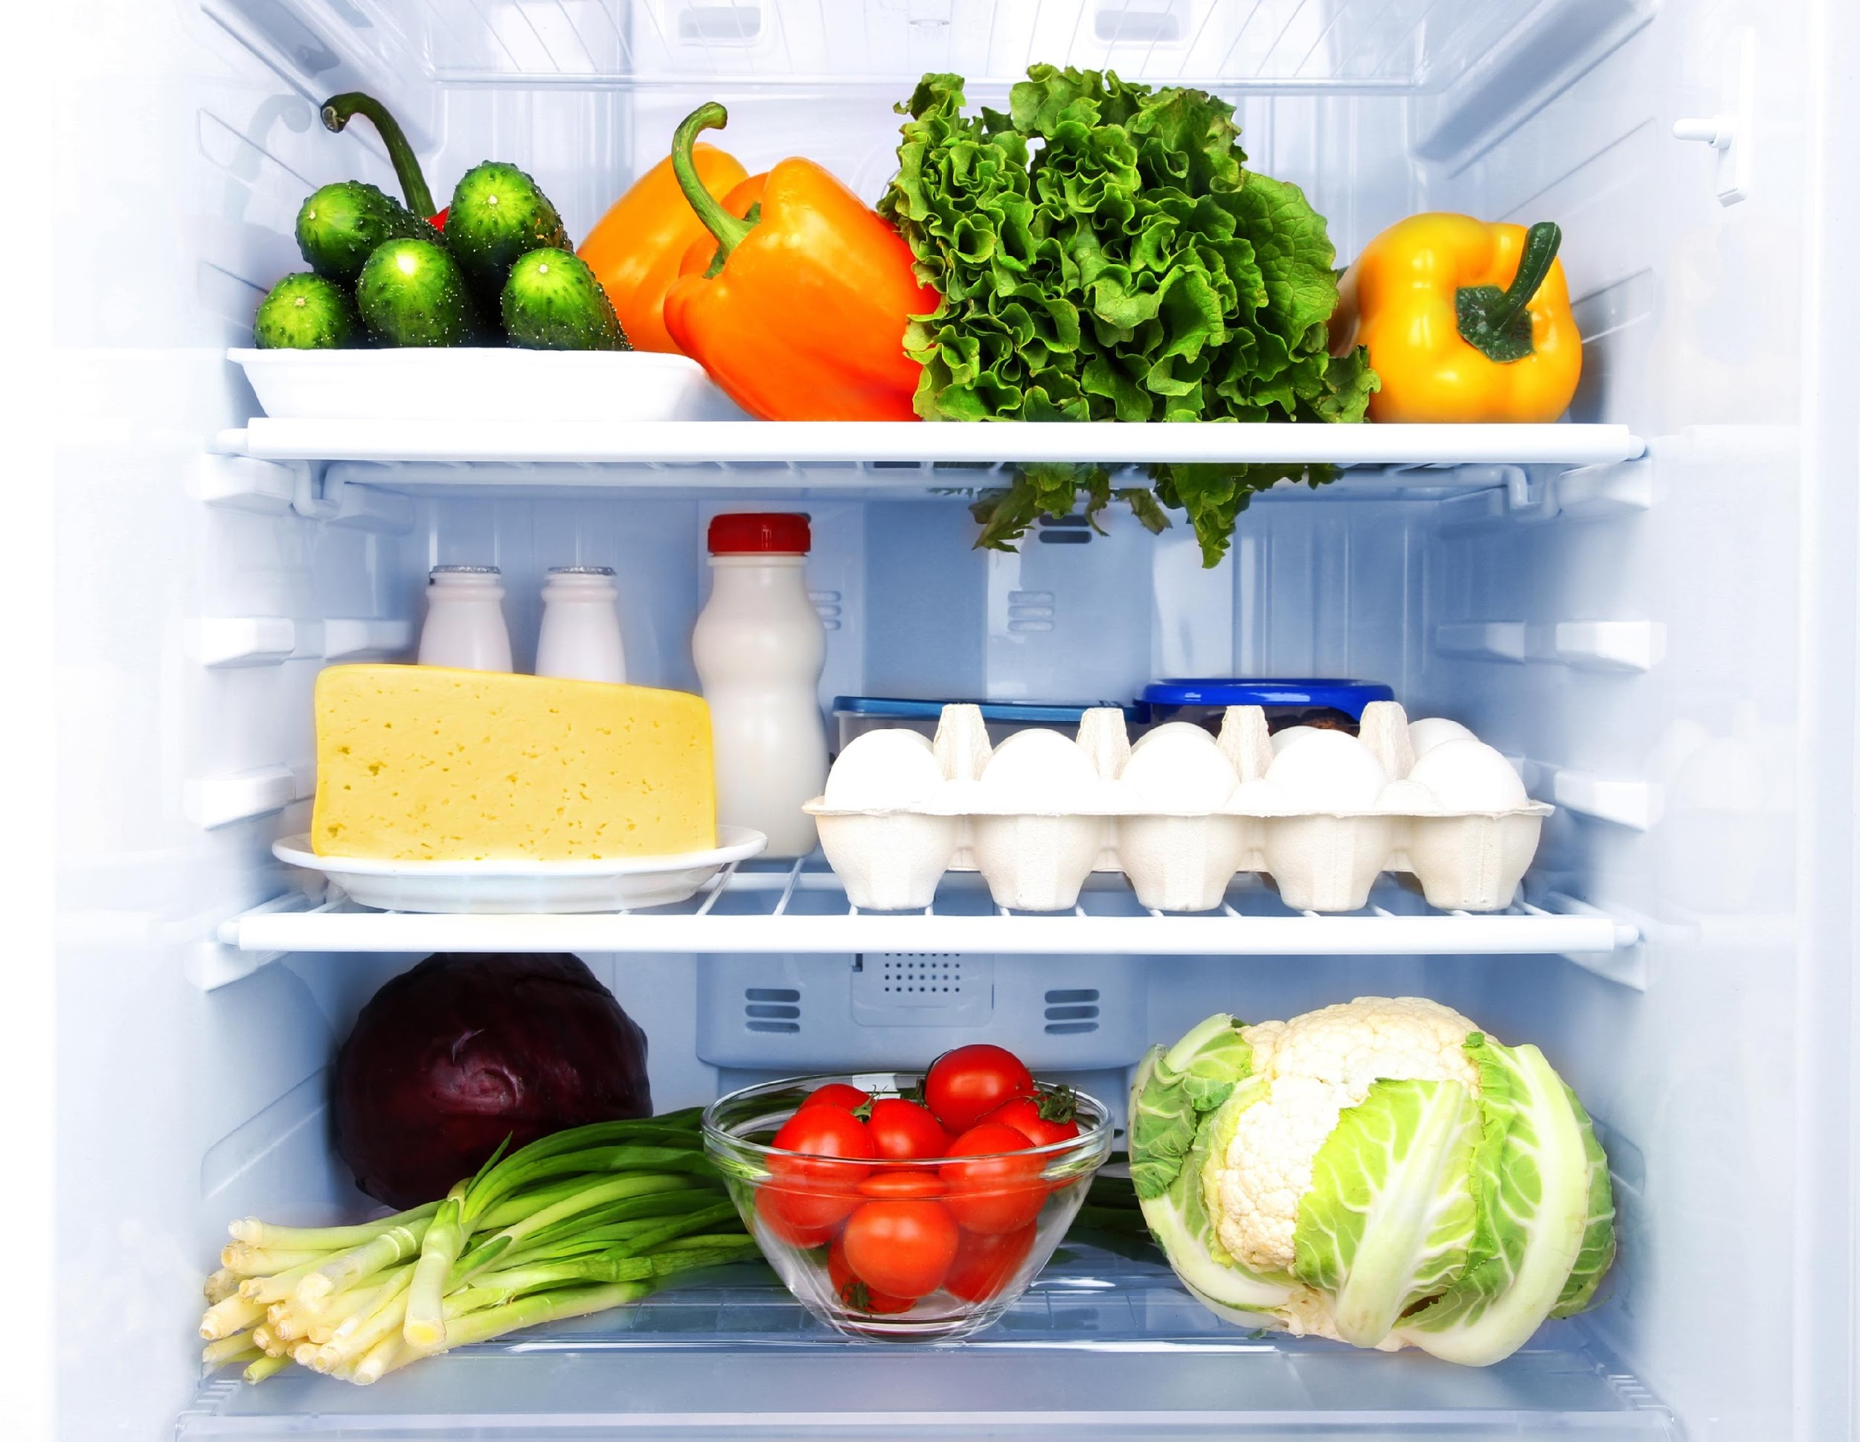
A key piece of information that is not currently being efficiently monitored is the use of food within your refrigerator

Slide 7
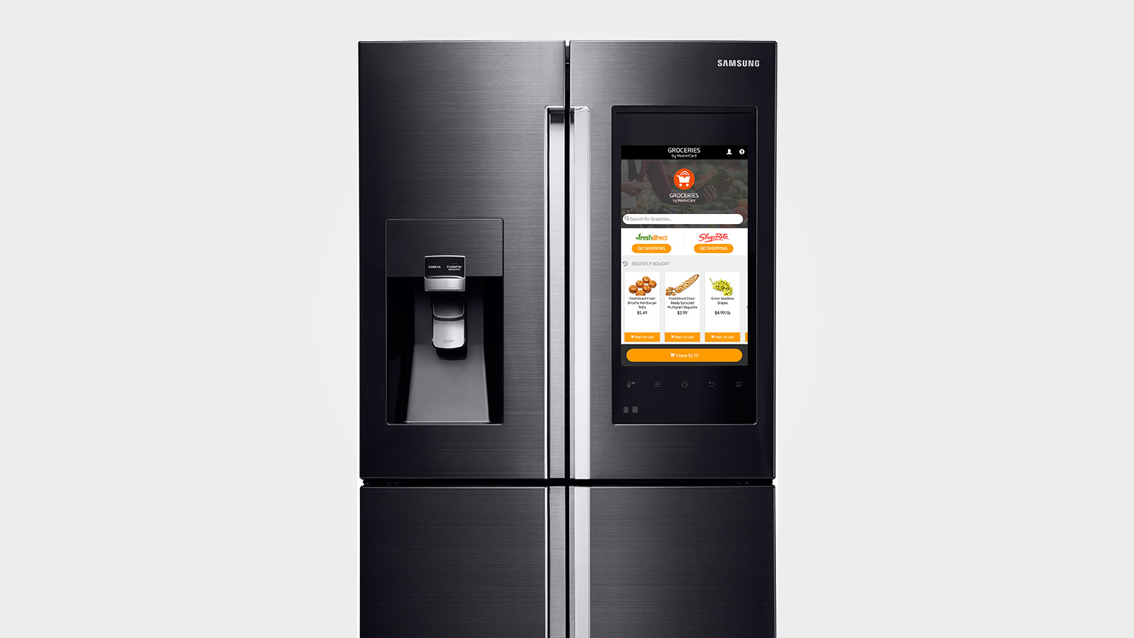
Current smart refrigerator solutions take images of the inside of the refrigerator to track inventory. Images are great for the user, but not for managing the basic components, your food.
Am I running out of eggs?
What is there to snack on?
Caution: Spoiled food!
What vegetables do I have?
When does my food expire?
Food calories?
Do I have enough
food to make lasagna?
How fresh is my milk?

Slide 8
Our goal is to take this device
to the next level

Slide 9
Development Process
This Project Consisted of 3 x (2 week) Sprints
Start
Finish

Slide 10
Our development team utilized a combination of the Agile and Scrum Processes to iteratively design and develop this application
This Project Consisted of 3 x (2 week) Sprints
Start
Finish

Slide 11






Our team used CSRA’s AppWrx Framework and associated development tools to create a web based application
Developer Management
Testing
Git
Jira
Junit
Selenium
Code Build And Configuration Management
Maven
Jenkins

Slide 12
Application Key Feature List
High Level
Platform independent and tablet friendly
Support multiple users
Shopping List Management
Allow users to create and have access to food they wish to purchase
Automatically add items in the refrigerator to the shopping list when they get low
Inventory Management
Allow users to keep track of food in their refrigerator
After food is purchased, move items from shopping list to inventory
Recipe Suggestions
Suggest recipes based on items currently in the refrigerator
Provide YouTube videos to assist with cooking

Slide 13
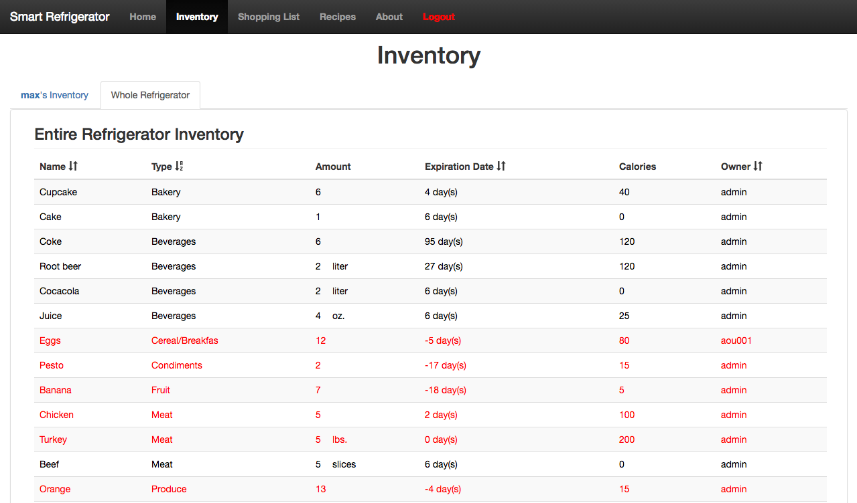
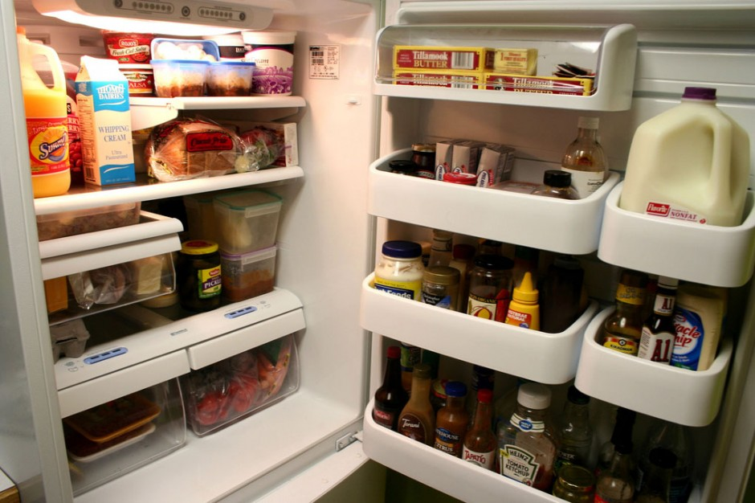
Scenario 1) A day in the life of Max and Jane when wondering what’s in their fridge
Max can open his phone and check his items, which are organized
Poor Max has to search through his entire fridge
OR

Slide 14
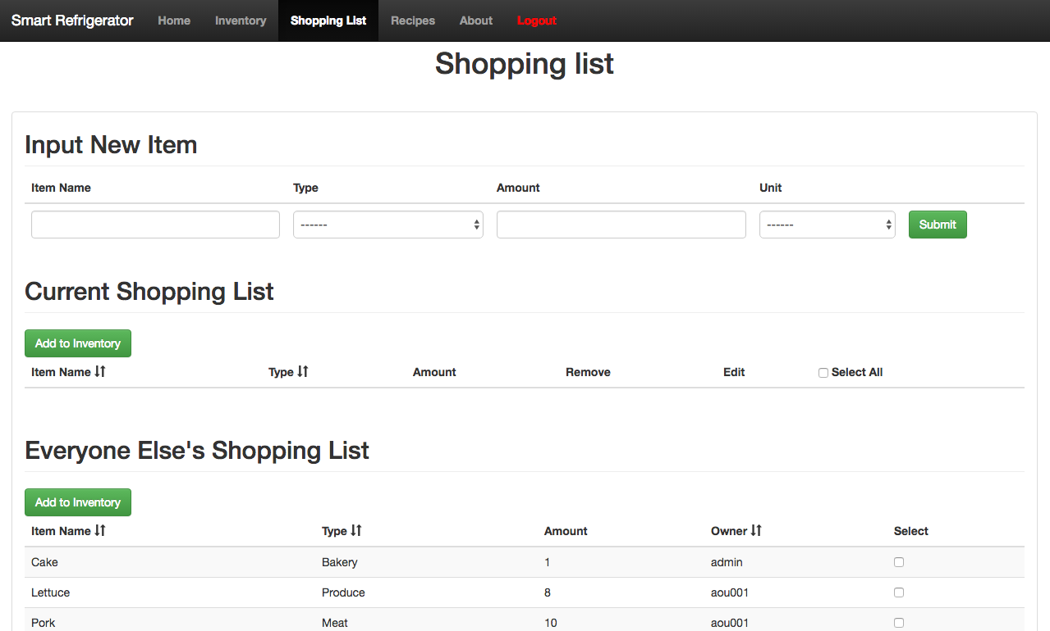
Scenario 2) Max and Jane are going to the store to buy things they need
Hassles
Figure out new things they want
Find the items that were expired
Identify the items that are running low
Remember to bring the physical list to the store
No Worries
Automatically adds items when they get low
Can easily add new things on the fly
Accessible on your phone
Seamlessly adds items back into inventory
OR

Slide 15
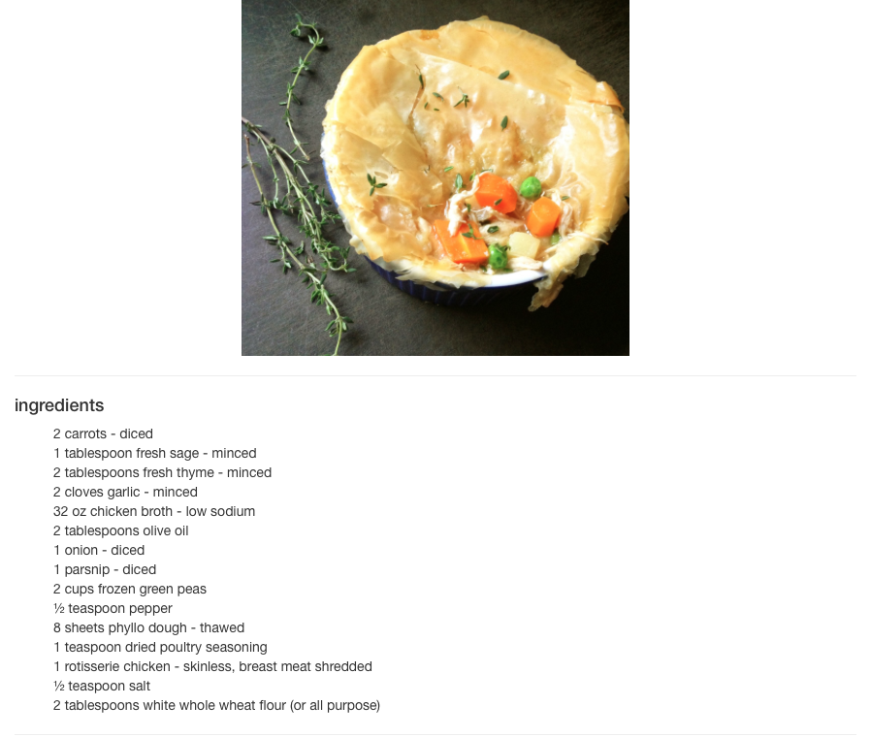


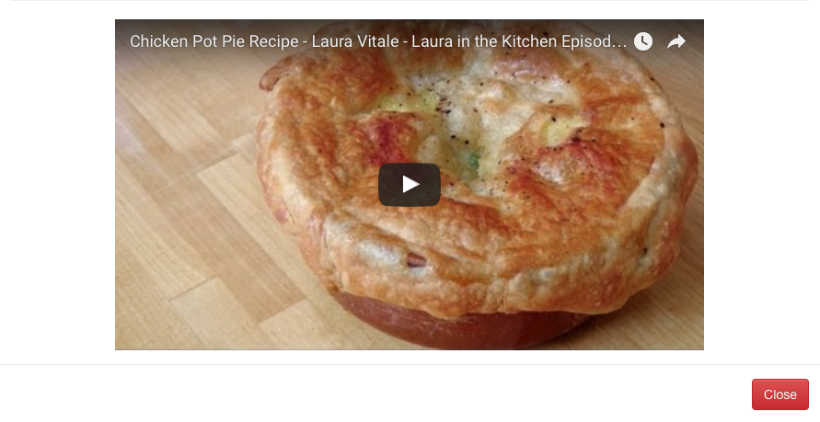
Scenario 3) Max and Jane are making a dish
Our couple has to hunt down recipes inside of books or go to the computer and find a website that may not be trustworthy
OR

Slide 16
Our team has created the next generation of smart refrigerator capable of managing your food and we look forward to making your life better where it counts

Slide 17
Demonstration and Questions

Slide 18
Images
https://i.ytimg.com/vi/NeULhhnui1Y/maxresdefault.jpg
http://www.10stunninghomes.com/wp-content/uploads/Samsung-Family-Hub-Smart-Fridge-CES-2016-3.jpg
http://a-muse-of-food.com/wordpress/wp-content/uploads/2015/06/foodinfridge.jpg
http://blog.esker.com/wp-content/uploads/2014/06/agile-methodology-implementation-esker-scrum-sprint11.jpg
https://torbjornzetterlund.com/git-pushing-your-code-to-two-different-source-code-control-system-using-github-client/
https://avatars1.githubusercontent.com/u/874086?v=3&s=400
https://maven.apache.org
https://wiki.jenkins-ci.org/download/attachments/2916393/logo-title.png?version=1&modificationDate=1302753947000
http://www.seleniumhq.org
https://www.atlassian.com/docroot/wac/resources/wac/img/social-icons/jira_logo.jpg
https://envatrace.com/wp-content/uploads/2015/04/20_cft_top_mount_stainless.jpg
http://www.polyvore.com/cgi/img-thing?.out=jpg&size=l&tid=399681
http://indianapublicmedia.org/amomentofscience/files/2011/08/174_fridge-940x626.jpg
https://marketingchristianbooks.files.wordpress.com/2011/09/stack-of-books.jpg
http://ww3.hdnux.com/photos/44/20/22/9503874/3/920x920.jpg

